Slide 1
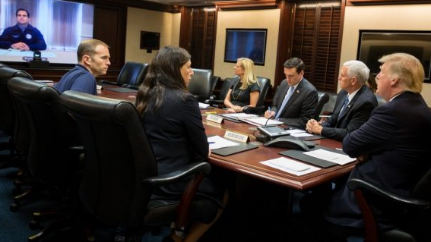
Welcome to the Situation Room:
A top-secret conference center in the basement of the
White House where national security decisions are made.
Notes:
Replace with trump in the situation room—
Also—compress photos so the Powerpoint isn't so big

Slide 2
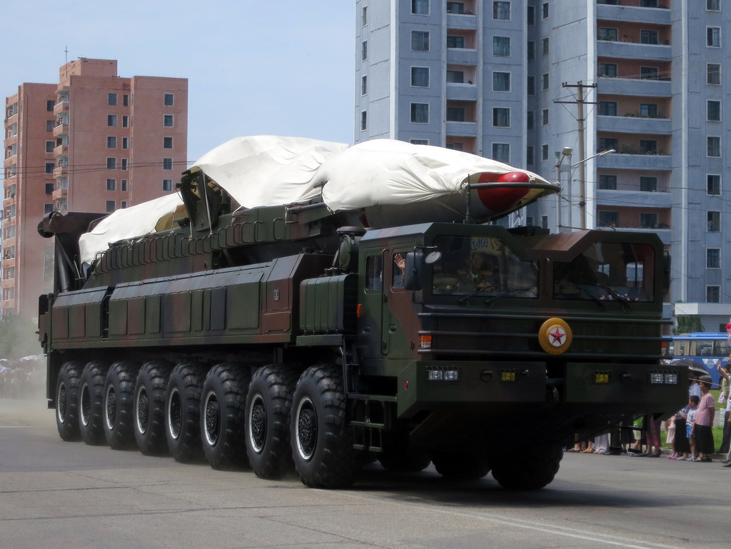
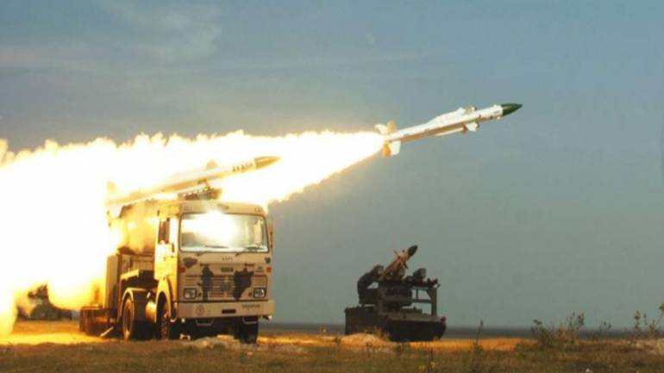
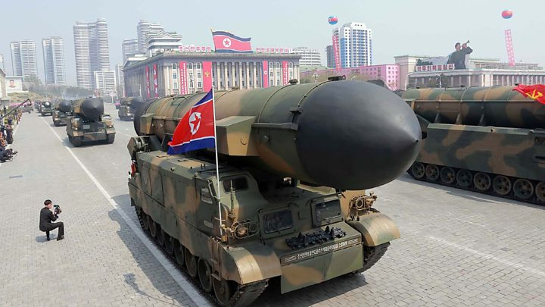
Today’s Topic:
What to do about nuclear North Korea?
Notes:
Change to “What to do about nuclear North Korea?”
Also—shrink map to show East Sea

Slide 3
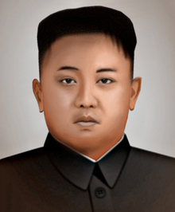
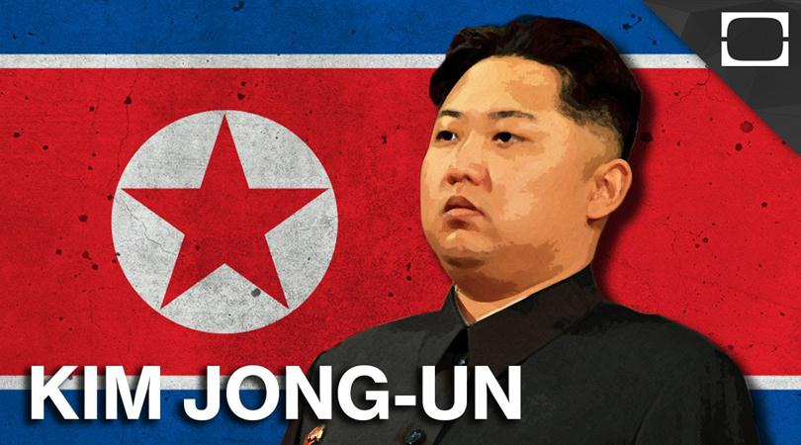
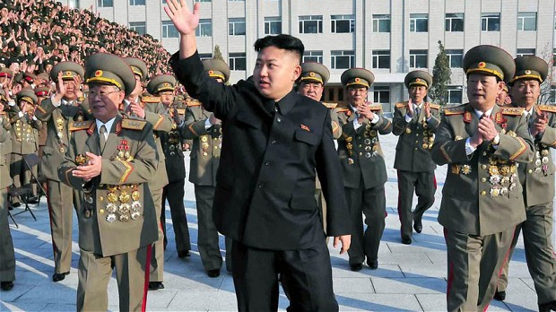
Background on the Crisis:
Since 2011, North Korea has been ruled by the 3rd generation of the Kim family, Kim Jong Un
Notes:
Change to “Has been ruled bythe 3rd generation of the Kim family, Kim Jong Un

Slide 4
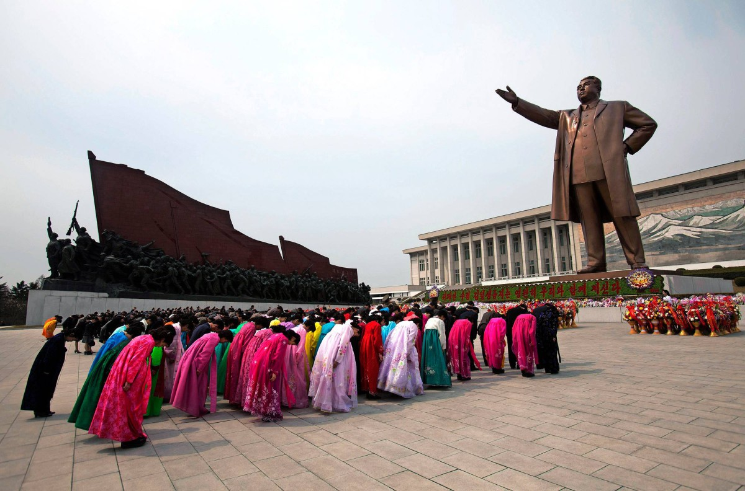
What is life in North Korea like?
Since 1948, there has been complete rule by the Kim family,
with no political rights for its citizens.

Slide 5
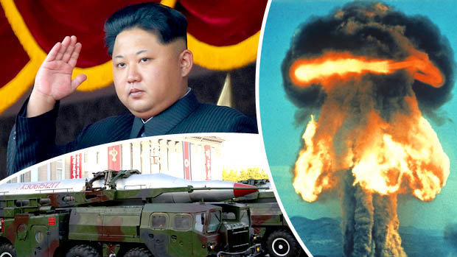
Background on the Crisis:
Along with his father and grandfather,
the Kim family has developed an arsenal of nuclear weapons

Slide 6
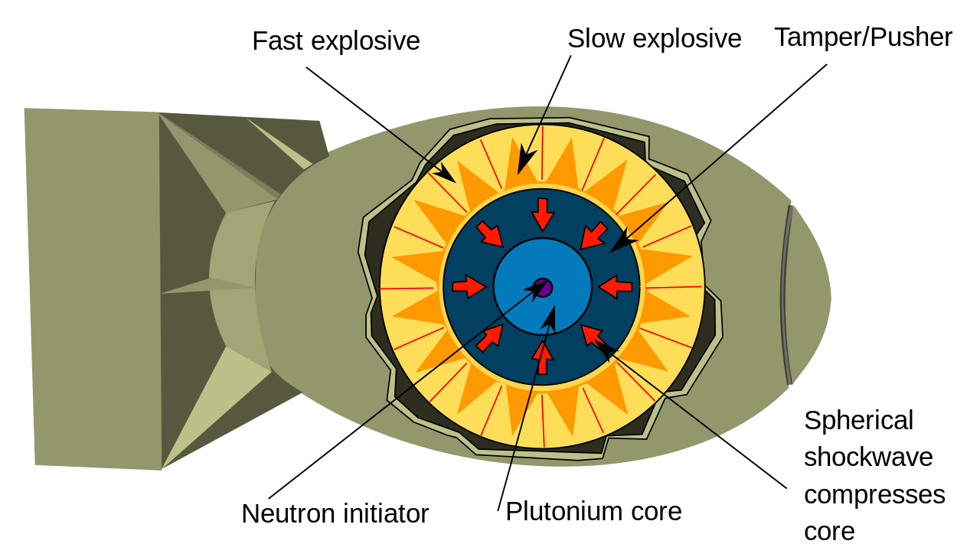
What are atomic or nuclear weapons?
Nuclear weapons are the most dangerous devices on earth. One can destroy a whole city, potentially killing millions.

Slide 7
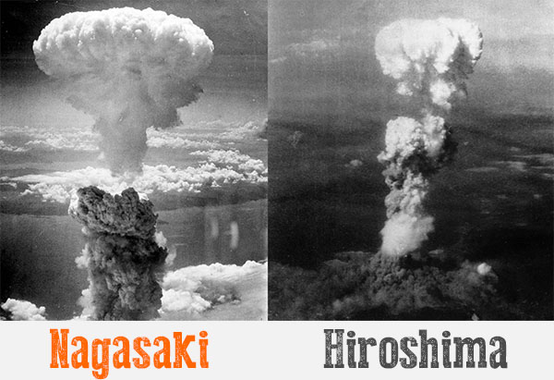
When were they first used?
In 1945 by the United States against Japan to end World War 2.

Slide 8
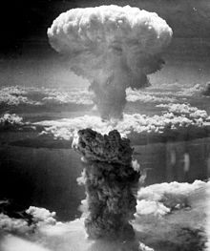
How an atomic explosion works
(Click here for a video on U.S. army nuclear weapon tests from the 1940’s.)

Slide 9
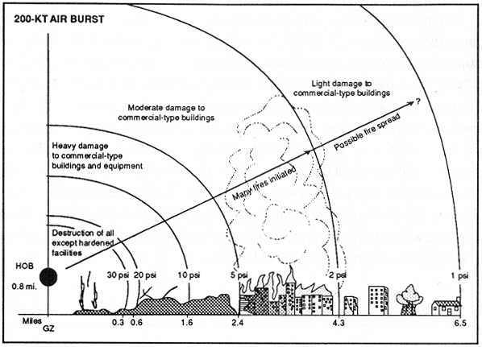
The damage from a basic atomic weapon

Slide 10
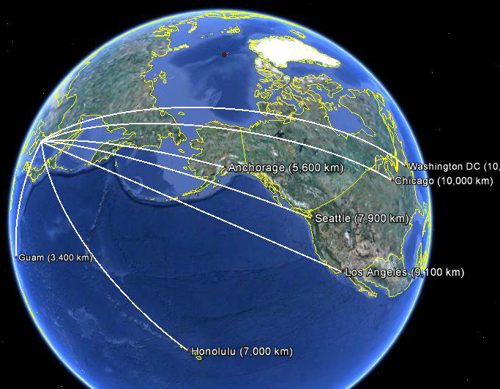
Why is the situation so dangerous today?
North Korea has almost developed the missiles that could carry a nuclear weapon to the United States.
Notes:
Change “What” to why

Slide 11
North Korea is trying to perfect an
InterContinental Ballistic Missile which could deliver a nuclear weapon to the United States.
Notes:
Replace without smoking

Slide 12
Video on the dangers of a nuclear North Korea

Slide 13
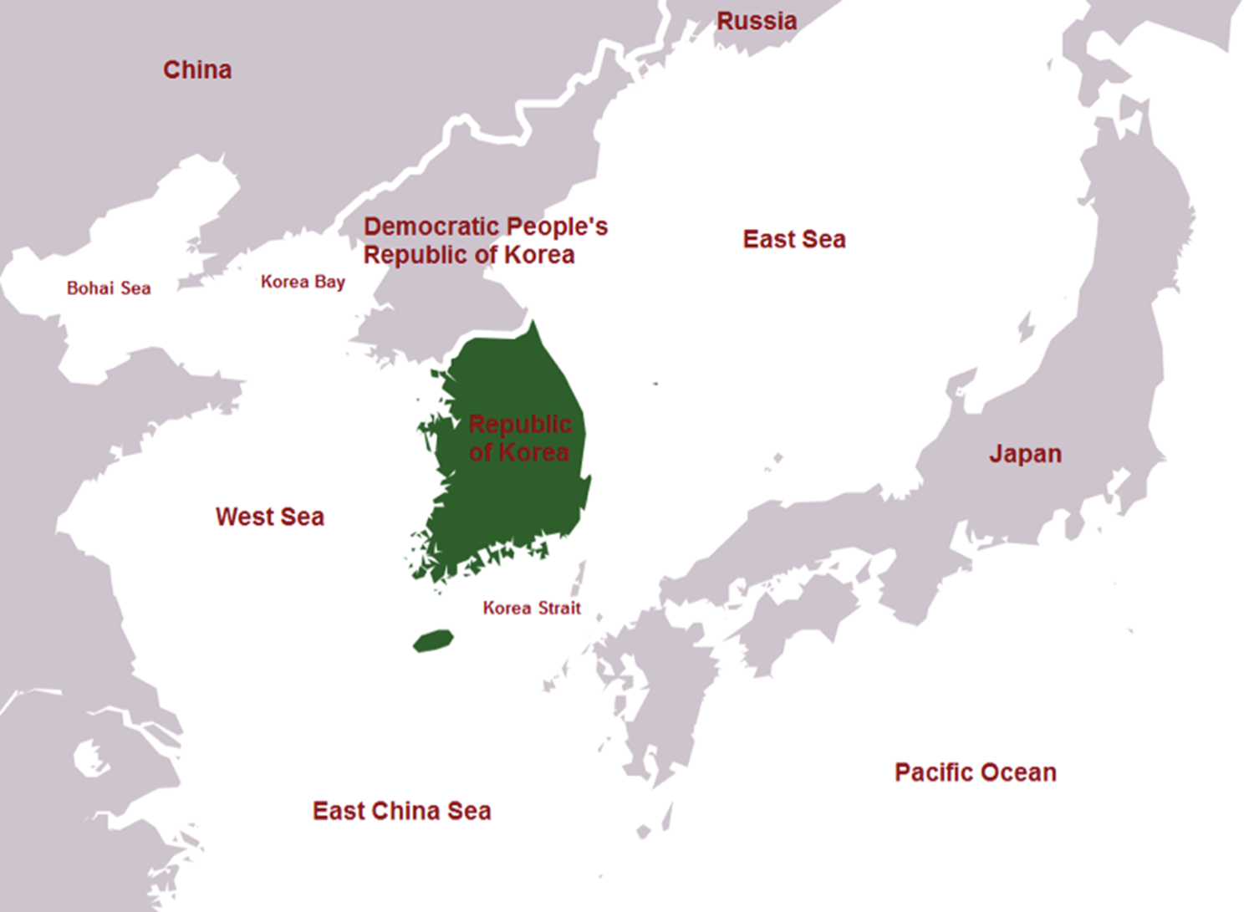
How should the United States and the world respond
to North Korea’s nuclear and ICBM tests?
Notes:
Replace --- with map that shows the East Sea as the primary name

Slide 14
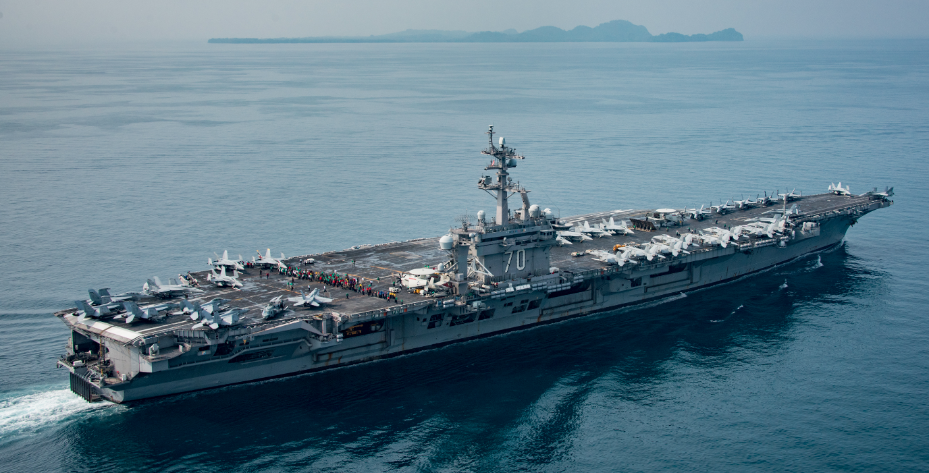
Option A:
Act Tough to Deter/Discourage
N. Korea from continuing its testing

Slide 15
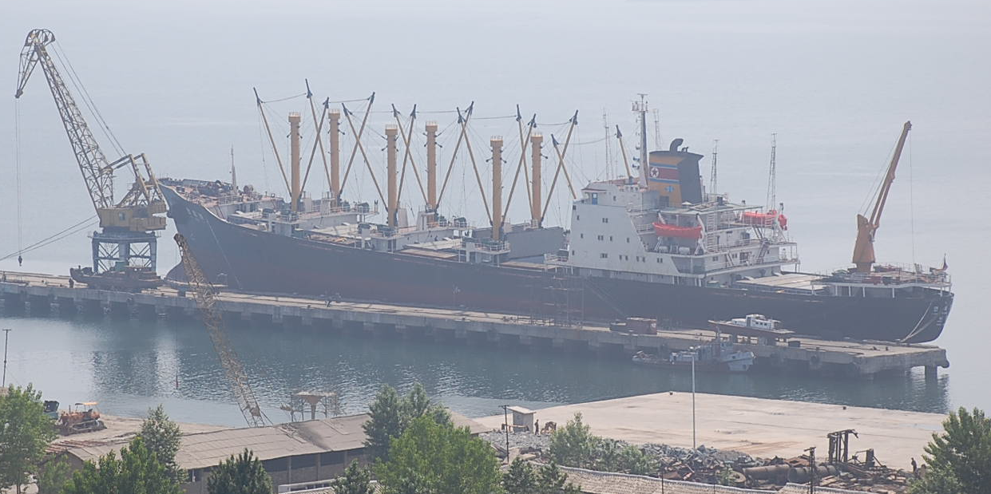
Option B:
Impose Sanctions/Penalties
against N. Korea or its partner China,
to restrict their trade and banking

Slide 16
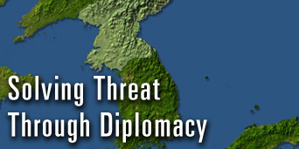
Option C:
Use Diplomacy, Dialogue,
and Negotiation
Notes:
Indicate 40 minute

Slide 17
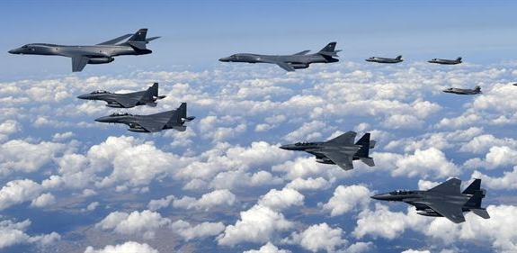
Option D:
Launch a Preventive Attack
on North Korea

Slide 18
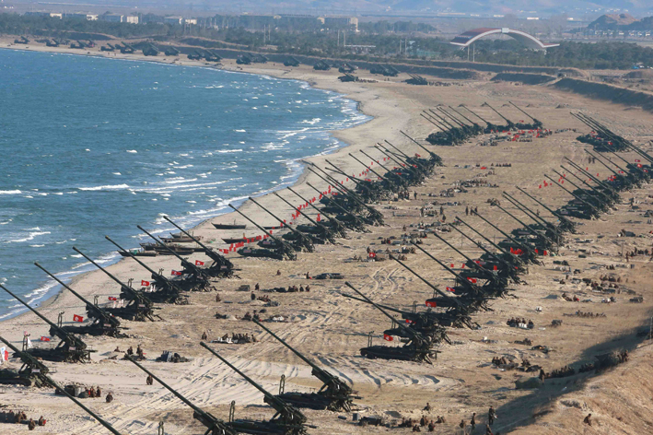
The Downsides:
North Korea would respond immediately with conventional, chemical, biological, and even nuclear weapons.
Casualty estimates range from hundreds of thousands to several millions, including more than 30,000 US troops and nearly 300,000 US citizens living in the region.

Slide 19
Downside:
N. Korea would target Seoul:
putting10 million citizens and the
world’s 11th largest economy at risk.

Slide 20
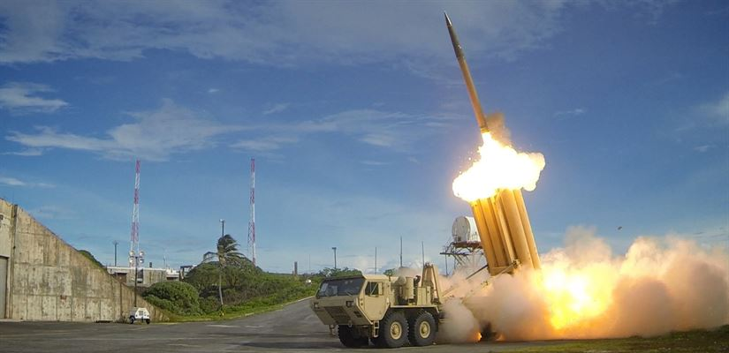
For Your Consideration:
The U.S. and S. Korea do have a missile defense network.
(The problem is that the technology is a “50/50” shot.)

Slide 21
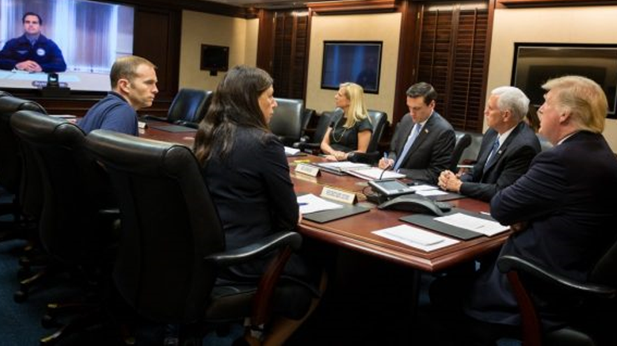
Mr. President:
What are the pros and cons to these options?
What will you decide?
Notes:
Change to trump

Slide 22
Next Steps for your class:
Please read and underline the options in the Student Packet.
From there, debate the choices and have the President decide.

